Slide 1
COVID-19: Impact on Risk & Insurance for Alternative Investment Managers
Sponsored by:

Slide 2
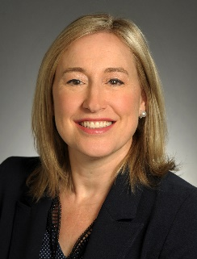
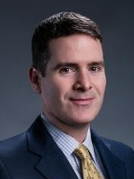
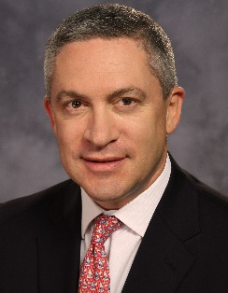
Agenda and Speakers
1
Welcome and introduction
2
Panelists review current issues and challenges
3
Q&A / Open discussion
Lexie Kindbom (Moderator)
Canada Head FINEX Financial Institutions
Tim Sullivan
FINEX Asset Management Industry Leader
Rob Yellen
Executive Vice President, FINEX North America, Directors and Officers and Fiduciary Liability Product Leader
4
Wrap up
Lexie.Kindbom@willistowerswatson.com
+1 416 216 0787
Timothy.Sullivan@willistowerswatson.com
+1 617 351 7435
Robert.Yellen@willistowerswatson.com
+1 917 574 1060

