Slide 1
Switzerland
Distribution of Collective Investment Schemes (CIS) and Key Regulatory Developments
Fedor Poskriakov, Partner
AIMA Navigating Private Placement | Singapore | 19 October 2017

Slide 2
Table of contents
Introduction
Distribution of CIS under Swiss law
      Concept of "distribution"
      Concept of "Qualified Investors"
      Distribution to Qualified Investors
      Status of investors – Examples
Examples - distribution / marketing scenarios
Managed accounts
Key Regulatory developments for CIS in Switzerland
      FinSA / FinIA

Slide 3
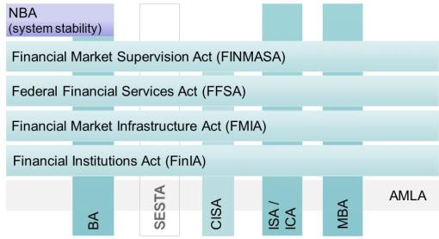
Introduction
The new architecture of the Swiss financial market regulation:
Source: Federal Department of Finance DFF

Slide 4
Distribution of CIS in Switzerland
Concept of "distribution"
Former concept of "public offering" replaced by the one of "distribution" with CISA
Definition of "distribution" (Article 3 CISA and Article 3 CISO)
Principle: any advertisement that is not directed exclusively at regulated qualified investors (Article 10 (3)(a) and (b) CISA) is considered to be distribution
Exceptions:
  Provision of information following an unsolicited request from an investor and/or an "execution only" client
  "Managed" clients (discretionary) of regulated financial intermediaries or of independent asset managers (subject to certain conditions)
  "Advisory" clients of regulated financial intermediaries or of independent asset managers (subject to certain conditions)
  Publication of prices, NAV and tax information
  Proposal of employee participation schemes in the form of collective investment (codification of the FINMA practice)

Slide 5
Distribution of CIS in Switzerland
Example triggers - distribution VS no distribution?
Cold calls to prospective investors, including emails, faxes, etc.?
Marketing a fund or strategy which is yet to be established ?
Arranging meetings with prospective investors by phone, email, etc. ?
One on one meetings with Swiss investors outside Switzerland ?
One on one meetings with Swiss investors inside Switzerland ?
Distributing investor letters, risk reports, presentations, DDQs, etc. ?
Attending or speaking at seminars attended by professional investors ?
Attending or speaking at seminars attended by any types of investors ?
Providing offering documents ?
Having a website which has no mention of Switzerland or CHF ?
Having a website which mentions Switzerland ?

Slide 6
Distribution of CIS in Switzerland
Reverse solicitation … still works under CISA, but:
No prior influence or approach by distributor, Swiss representative or asset manager
Investor requests, on an unsolicited basis, information regarding a specific security
Narrow scope of application (Swiss finish) means that reverse solicitation can only be serviced on a selective basis with regard to the above requirements and should be properly documented (e.g., written investor request)
Information obligation of distributor applies
Duty to document
  Obligation to establish a protocol regarding the result of the assessment of investor’s needs and reasons for recommendation of a collective investment scheme (Article 34a CISO)

Slide 7
Distribution of CIS in Switzerland
Concept of "Qualified Investors"

Slide 8
Distribution of CIS in Switzerland
Distribution to "Qualified Investors"
Target Investor | Place of distribution | Location of Distributor | Out of scope or in scope of CISA | Requirement for Distributor | Requirement for Fund
Regulated Qualified Investor | Switzerland or outside Switzerland | Switzerland or outside Switzerland | Out of scope (Art. 3 para. 1 CISA) | N/A | N/A
Unregulated Qualified Investor pursuant to CISA or foreign law | outside Switzerland | Switzerland | Out of scope (Art. 2 para. 1 lit. e CISA a contrario and Art. 1 CISO) | N/A | N/A
Unregulated Qualified Investor | Switzerland | Switzerland | In scope | "Appropriate supervision" of distributor + Licence as a distributor required (Art. 19 para. 1bis CISA, Art. 30a CISO)* | No registration with FINMA, but Swiss representative and paying agent Name of the fund not misleading (Art. 120 para. 4 CISA)
Unregulated Qualified Investor | Switzerland | outside Switzerland | In scope | "Appropriate supervision" of distributor + Licence as a distributor required (Art. 19 para. 1bis CISA, Art. 30a CISO) | No registration with FINMA, but Swiss representative and paying agent Name of the fund not misleading (Art. 120 para. 4 CISA)

Slide 9
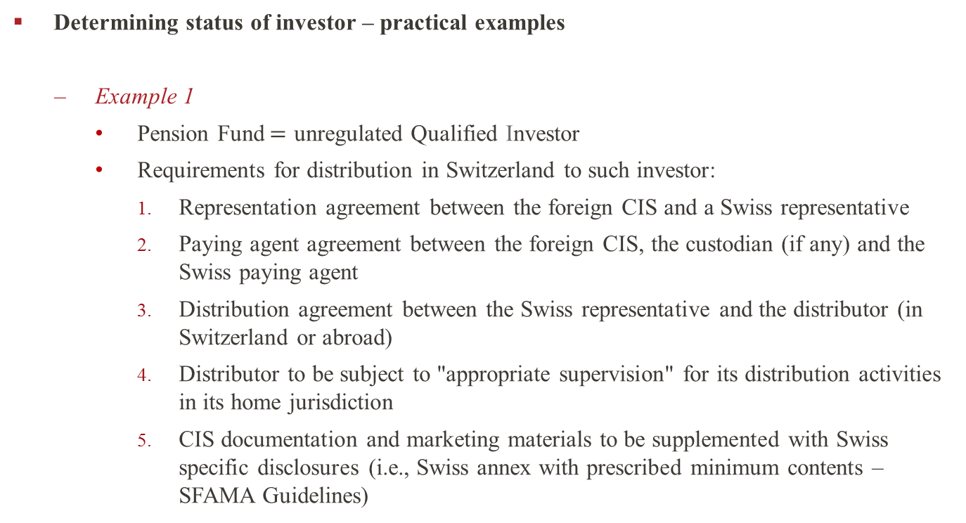
Distribution of CIS in Switzerland
Determining status of investor – practical examples
Example 1
  Pension Fund$=$ unregulated Qualified Investor
  Requirements for distribution in Switzerland to such investor:
    Representation agreement between the foreign CIS and a Swiss representative
    Paying agent agreement between the foreign CIS, the custodian (if any) and the Swiss paying agent
    Distribution agreement between the Swiss representative and the distributor (in Switzerland or abroad)
    Distributor to be subject to "appropriate supervision" for its distribution activities in its home jurisdiction
    CIS documentation and marketing materials to be supplemented with Swiss specific disclosures (i.e., Swiss annex with prescribed minimum contents – SFAMA Guidelines)

Slide 10
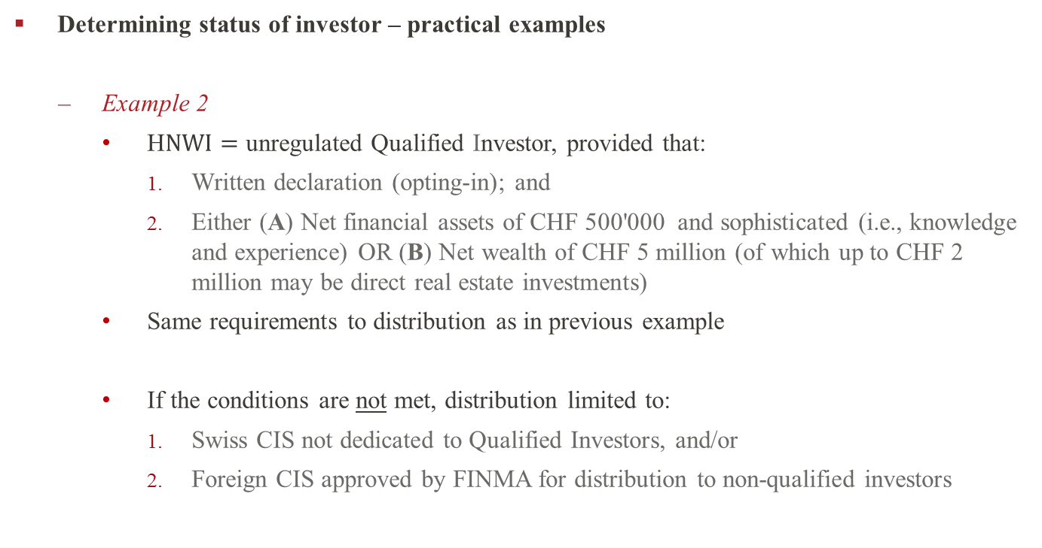
Distribution of CIS in Switzerland
Determining status of investor – practical examples
Example 2
  H$NWI=$ unregulated Qualified Investor, provided that:
    Written declaration (opting-in); and
    Either (A) Net financial assets of CHF 500'000 and sophisticated (i.e., knowledge and experience) OR (B) Net wealth of CHF 5 million (of which up to CHF 2 million may be direct real estate investments)
  Same requirements to distribution as in previous example
  If the conditions are not met, distribution limited to:
    Swiss CIS not dedicated to Qualified Investors, and/or
    Foreign CIS approved by FINMA for distribution to non-qualified investors

Slide 11
Examples - distribution / marketing scenarios
Distribution to regulated financial intermediary who further distributes to NQI with no discretionary or advisory agreement
Placement of any foreign
and Swiss domiciled CIS
Distribution of registered foreign
and Swiss domiciled CIS only
Fund Promoter
No Distribution
Bank
Distribution to NQI
NQI
Distribution to NQI
Distribution of registered foreign CIS and Swiss domiciled funds only
FINMA approval of foreign CIS required (may not be available to all foreign CIS, subject to strict regulatory requirements)
Appointment of Swiss Representative and Swiss Paying Agent mandatory
Entering into a Distribution Agreement in accordance with the SFAMA model distribution agreement for NQI ("SFAMA NQI Agreement")

Slide 12
Examples - distribution / marketing scenarios
Distribution to regulated financial intermediary who further distributes to non-regulated QI with no discretionary or advisory agreement
Placement of any foreign and Swiss domiciled CIS
Distribution of registered and non-registered foreign CIS and Swiss domiciled CS
Distribution to non-regulated QI
Fund Promoter
No Distribution
non-regulated QI
Bank
Distribution of registered and non-registered foreign CIS and Swiss domiciled CIS
Appointment of Swiss Representative and Swiss Paying Agent mandatory
Entering into a Distribution Agreement in accordance with the SFAMA model distribution agreement for non-regulated QI ("SFAMA QI Agreement")

Slide 13
Examples - distribution / marketing scenarios
Distribution to IFA with discretionary or advisory agreement with NQI
Distribution of any foreign and Swiss CIS (subject to the above)
Placement of any foreign and Swiss domiciled CIS
Fund Promoter
Distribution
No Distribution
NQI with discretionary or advisory agreement
Self-regulated IFA
Distribution to unregulated Qualified Investor, subject to conditions
Appointment of Swiss representative and Swiss paying agent
Written self-certification by IFA (including (a) use of CIS information by IFA for only client that are Qis, and (b) certification as to IFA status)
No conclusion of a distribution agreement with the IFA, but written self-certification required
Distribution agreement with the Swiss representative in accordance with the SFAMA QI Agreement (Fund Promoter)

Slide 14
Examples - distribution / marketing scenarios
Distribution to a private investment structure (Article 6a CISO)
Distribution of registered and non-registered foreign and Swiss domiciled CIS
Private investment structure
(Art. 6a CISO)
Fund Promoter
HNWI
Distribution to non-regulated Qualified Investor
Appointment of Swiss representative and Swiss paying agent mandatory
Distribution agreement in accordance with the SFAMA QI Agreement
Verification of, and certification of status by, private investment structure in accordance with Article 6a CISO

Slide 15
Frequent questions – distribution
Timing of appointment of the Swiss representative and paying agents
  Trigger: "Distribution"
  Special case of "pre-marketing/sales" activities
Compliance with SFAMA Distribution Rules
Role of Swiss paying agent
Role of foreign custodian and transfer agent (if any)
Termination of:
  Distribution agreement?
  Representation agreement / Paying agency agreement?
"Swiss Information" for the distribution to unregulated QI
  Contents and format
  Trailer fees / rebates mandatory disclosures

Slide 16
Managed accounts
Managed account = financial service, not a financial product
Cross-border offering of services requirements:
  No registration, approval or licensing in Switzerland, provided that:
    No presence in Switzerland (i.e., no representative office, or branch)
    Not a remote member of Swiss exchange
    No marketing of consumer loans
  Facts-driven analysis of offering to make sure that only financial service
Marketing of "strategies"
Management of client's assets on the basis of powers of attorney
Consumer protection limitations (i.e., governing law, forum, etc.)

Slide 17
Key Regulatory Developments for CIS in Switzerland
FMIA – disclosure of shareholdings / derivatives, and other rules already in force
FinSA/FinIA – draft legislation in discussion : key issues
  Financial Services to be regulated in a similar way as under MiFID II, incl. rules of conduct and suitability, but with potential key differences (e.g., client classification, opting-in/-out, remuneration guidelines, rebates/inducements, supervision of advisors or distributors, Base Information Fact Sheet, cross-border activities, no target market analysis/restrictions, different rules on research)
  Supervision of independent asset managers and trustees (delegated model, i.e., FINMA → SROs ongoing supervision)
  No supervision of advisors
  Distributor status to be abolished
  Swiss and foreign "client advisors" requirements (i.e., registration, training, etc.)
  Public register of "client advisors"
  Consequences for cross-border activities / marketing of CIS
FinSA/FinIA : currently pending before Parliament / entry into force in 2018/2019
(most likely 01 January 2019)

Slide 18
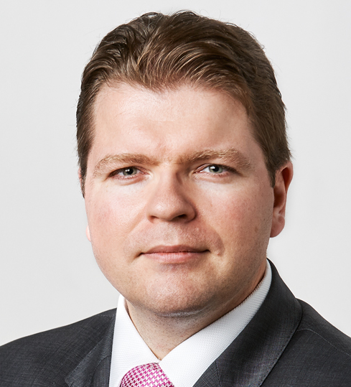
Questions
Fedor Poskriakov
Partner, Geneva
Telephone +41 58 450 71 31
fedor.poskriakov@lenzstaehelin.com

