Slide 1


CIFSC Alternative Fund Categorization
Presented by
Reid Baker, CERA, ASA
Chair, Canadian Investment Funds Standards Committee
Director, Analytics & Data, Fundata Canada Inc.

Slide 2

Presentation Overview
CIFSC Background
Alternative Category Overview
Potential New Alternative Category Segments
Performance Comparisons and Benchmark Selection
Risk Ratings

Slide 3
CIFSC Background
Formed in 1998 by Canada’s major data providers
Covers 100% of the retail investment products in Canada
5 voting and 5 non-voting members
New funds, category change requests, category review

Slide 4
Category Overview
Background on how we arrived at the current category set up
Review of the category definitions and the intent of each category

Slide 5
Category Overview
Alternative Mutual Funds
Hedge Funds
New Alternative Categories

Slide 6
Category Overview
Multi-Strategy | Rank
Alt Mutual Fund ABC | 1
Alt Mutual Fund XYZ | 2
Alt Mutual Fund 123 | 3
Multi-Strategy | Rank
Hedge Fund ABC | 1
Hedge Fund XYZ | 2
Hedge Fund 123 | 3
Hedge Fund 456 | 4
Hedge Fund ZZZ | 5

Slide 7
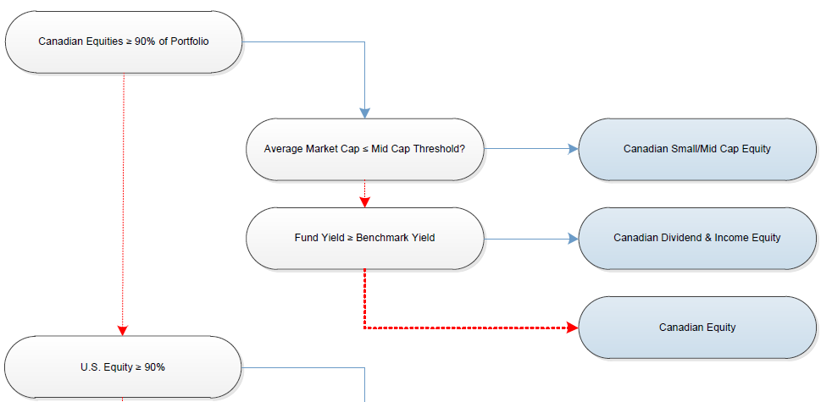
Category Overview

Slide 8
Category Overview
No strict thresholds initially - 2 Reasons:
1.Data 2. Arbitrary
Holdings Data? Frequency?
Insufficient data to create meaningful thresholds
Net Exposures?
Beta
S&P 500? TSX? MSCI World?

Slide 9
Category Overview
Alternative Strategies
Alternative Equity Focused
Alternative Credit Focused
Alternative Multi-Strategy
Alternative Market Neutral
Alternative Other

Slide 10
Category Overview
Alternative Equity Focused
Funds in the Alternative Equity Focused category employ alternative strategies such as short selling or other forms of leverage. Alternative Mutual Funds that meet the requirements of NI 81-102, and traditional hedge funds offered by offering memorandum are categorized using the same guidelines. The underlying securities should be primarily equities such that at least 50% of the portfolio is invested in equities. Funds in this category may use speculative and/or hedging strategies. Funds that do not issue a simplified prospectus will not be ranked with the Alternative Mutual Funds in this category.
*This category will not be ranked for the first year of its existence.

Slide 11
Category Overview
Alternative Credit Focused
Funds in the Alternative Credit Focused category employ alternative strategies such as short selling or other forms of leverage. Alternative Mutual Funds that meet the requirements of NI 81-102, and traditional hedge funds offered by offering memorandum are categorized using the same guidelines. The underlying securities should be primarily fixed income such that at least 50% of the portfolio is invested in fixed income or credit related products. Funds in this category may use speculative and/or hedging strategies. Funds that do not issue a simplified prospectus will not be ranked with the Alternative Mutual Funds in this category.
*This category will not be ranked for the first year of its existence.

Slide 12
Category Overview
Alternative Multi-Strategy
Funds in the Alternative Multi - Strategy category employ alternative strategies such as short selling or other forms of leverage. Alternative Mutual Funds that meet the requirements of NI 81-102, and traditional hedge funds offered by offering memorandum are categorized using the same guidelines. Funds in this category must have a stated mandate to use any, or a combination, of the alternative strategies including strategies that can be found in the other alternative categories. Funds that do not issue a prospectus will not be ranked with the Alternative Mutual Funds in this category.
*This category will not be ranked for the first year of its existence.

Slide 13
Category Overview
Alternative Market Neutral
Funds in the Alternative Market Neutral category employ alternative strategies such as short selling or other forms of leverage. Alternative Mutual Funds that meet the requirements of NI 81-102, and traditional hedge funds offered by offering memorandum are categorized using the same guidelines. Funds in this category aim to reduce market exposure by pairing long and short positions. These funds generally aim to have low correlation and/or low beta to relative markets. Funds that do not issue a simplified prospectus will not be ranked with the Alternative Mutual Funds in this category.
*This category will not be ranked for the first year of its existence.

Slide 14
Category Overview
Alternative Other
Funds in the Alternative Other category have a unique strategy that does not fit in to any other alternative category. Alternative Mutual Funds that meet the requirements of NI 81-102, and traditional hedge funds offered by offering memorandum are categorized using the same guidelines. Funds in this category will not be ranked.
*This category will not be ranked for the first year of its existence.

Slide 15
Category Overview
 | Total | Alternative Mutual Funds | Other Alternative Funds
Equity Focused | 175 | 19 | 156
Credit Focused | 39 | 4 | 35
Multi-Strategy | 70 | 13 | 57
Market Neutral | 28 | 3 | 25
Other | 56 | 2 | 54

Slide 16
Potential New Alternative Categories
New categories needed!

Slide 17
Potential New Alternative Categories
Global Macro?
Alternative Equity Focused
Alternative Multi-Strategy
Alternative Other

Slide 18
Potential New Alternative Categories
Absolute Return?
Alternative Market Neutral
Alternative Multi-Strategy
Alternative Credit Focused

Slide 19
Potential New Alternative Categories
Private Equity & Private Credit?
Alternative Other

Slide 20
Performance Comparisons & Benchmark Selection
The CIFSC does not do performance rankings or benchmark selection
Data Providers

Slide 21
Performance Comparisons & Benchmark Selection
No rankings for the first year:
Higher than normal fund movement expected
New funds no historical data
Risk / Return profiles might not align
Small number of funds in some categories
Splitting out new categories in a year

Slide 22
Performance Comparisons & Benchmark Selection
ALT Mutual Fund XYZ ALT Mutual Fund 123

Slide 23
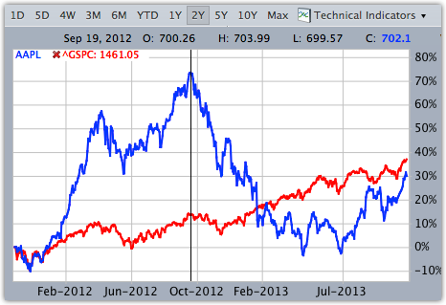
Performance Comparisons & Benchmark Selection

Slide 24
Performance Comparisons & Benchmark Selection
CIFSC Categories
Scotiabank Categories
Alternative Equity Focused
Equity Hedge
CTA
Alternative Credit Focused
Equity Market Neutral
Alternative Multi-Strategy
Fixed Income
Alternative Market Neutral
Global Macro
Alternative Other
Multi-Strategy

Slide 25
Risk Ratings
The CIFSC does not assign risk ratings
Regulators

Slide 26
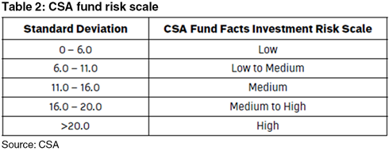
Risk Ratings
10 Year Standard Deviation

Slide 27
Risk Ratings
Max Drawdown
Standard Deviation
Risk Rating
Low
Low to Medium
Medium
Medium to High
High
Up/Down Capture
Batting Average
Liquidity

Slide 28
Thank You!
Questions?

